Slide 1
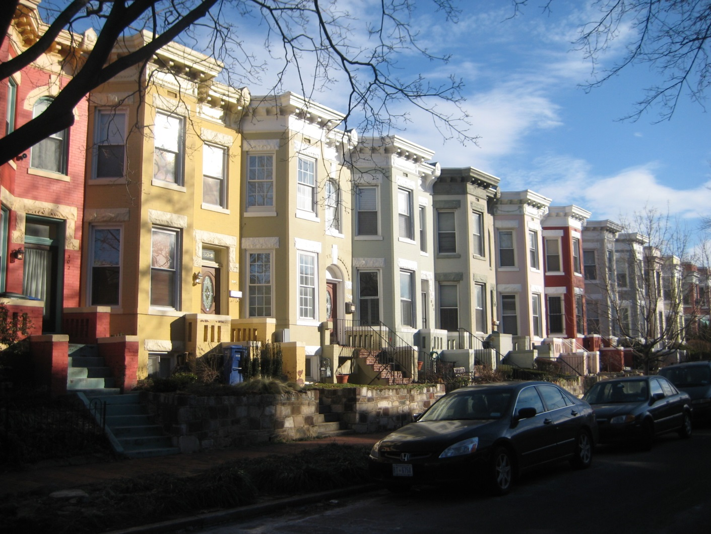

Capitol Hill Historic District
Boundary Expansion
May 28, 2015
HPRB Case 15-01

Slide 2
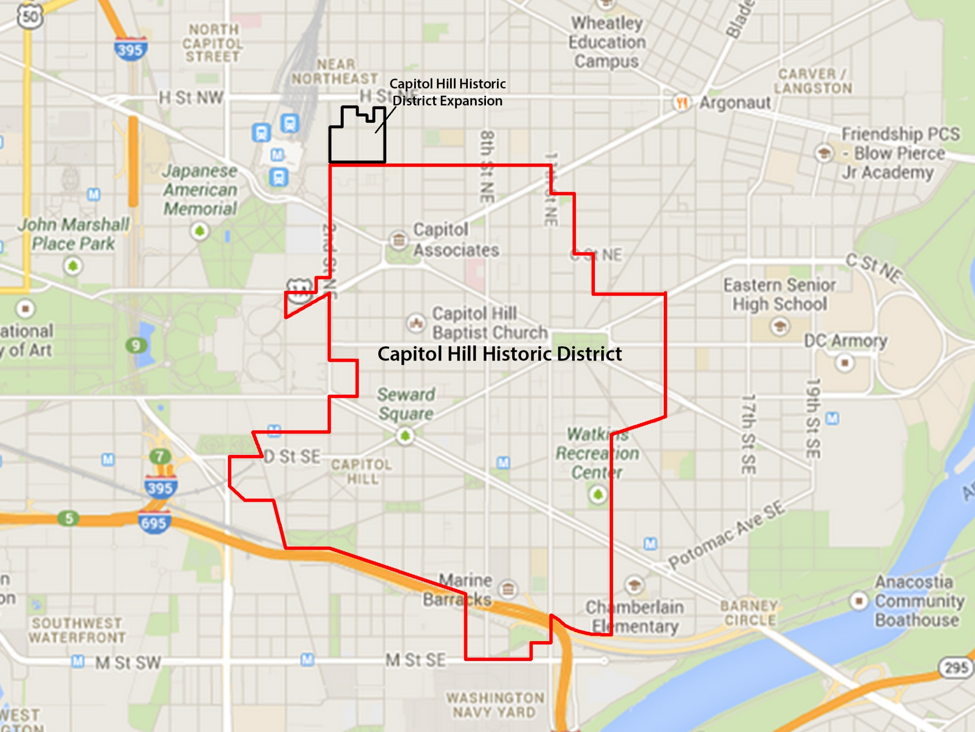

Slide 3
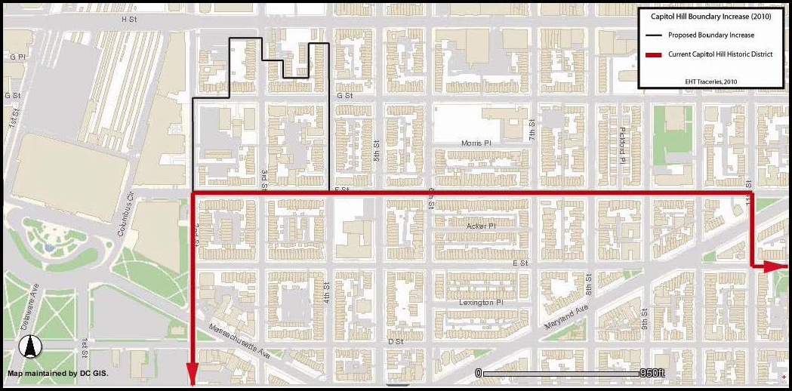
SQUARE 752
SQUARE 777
SQUARE 753
SQUARE 778

Slide 4
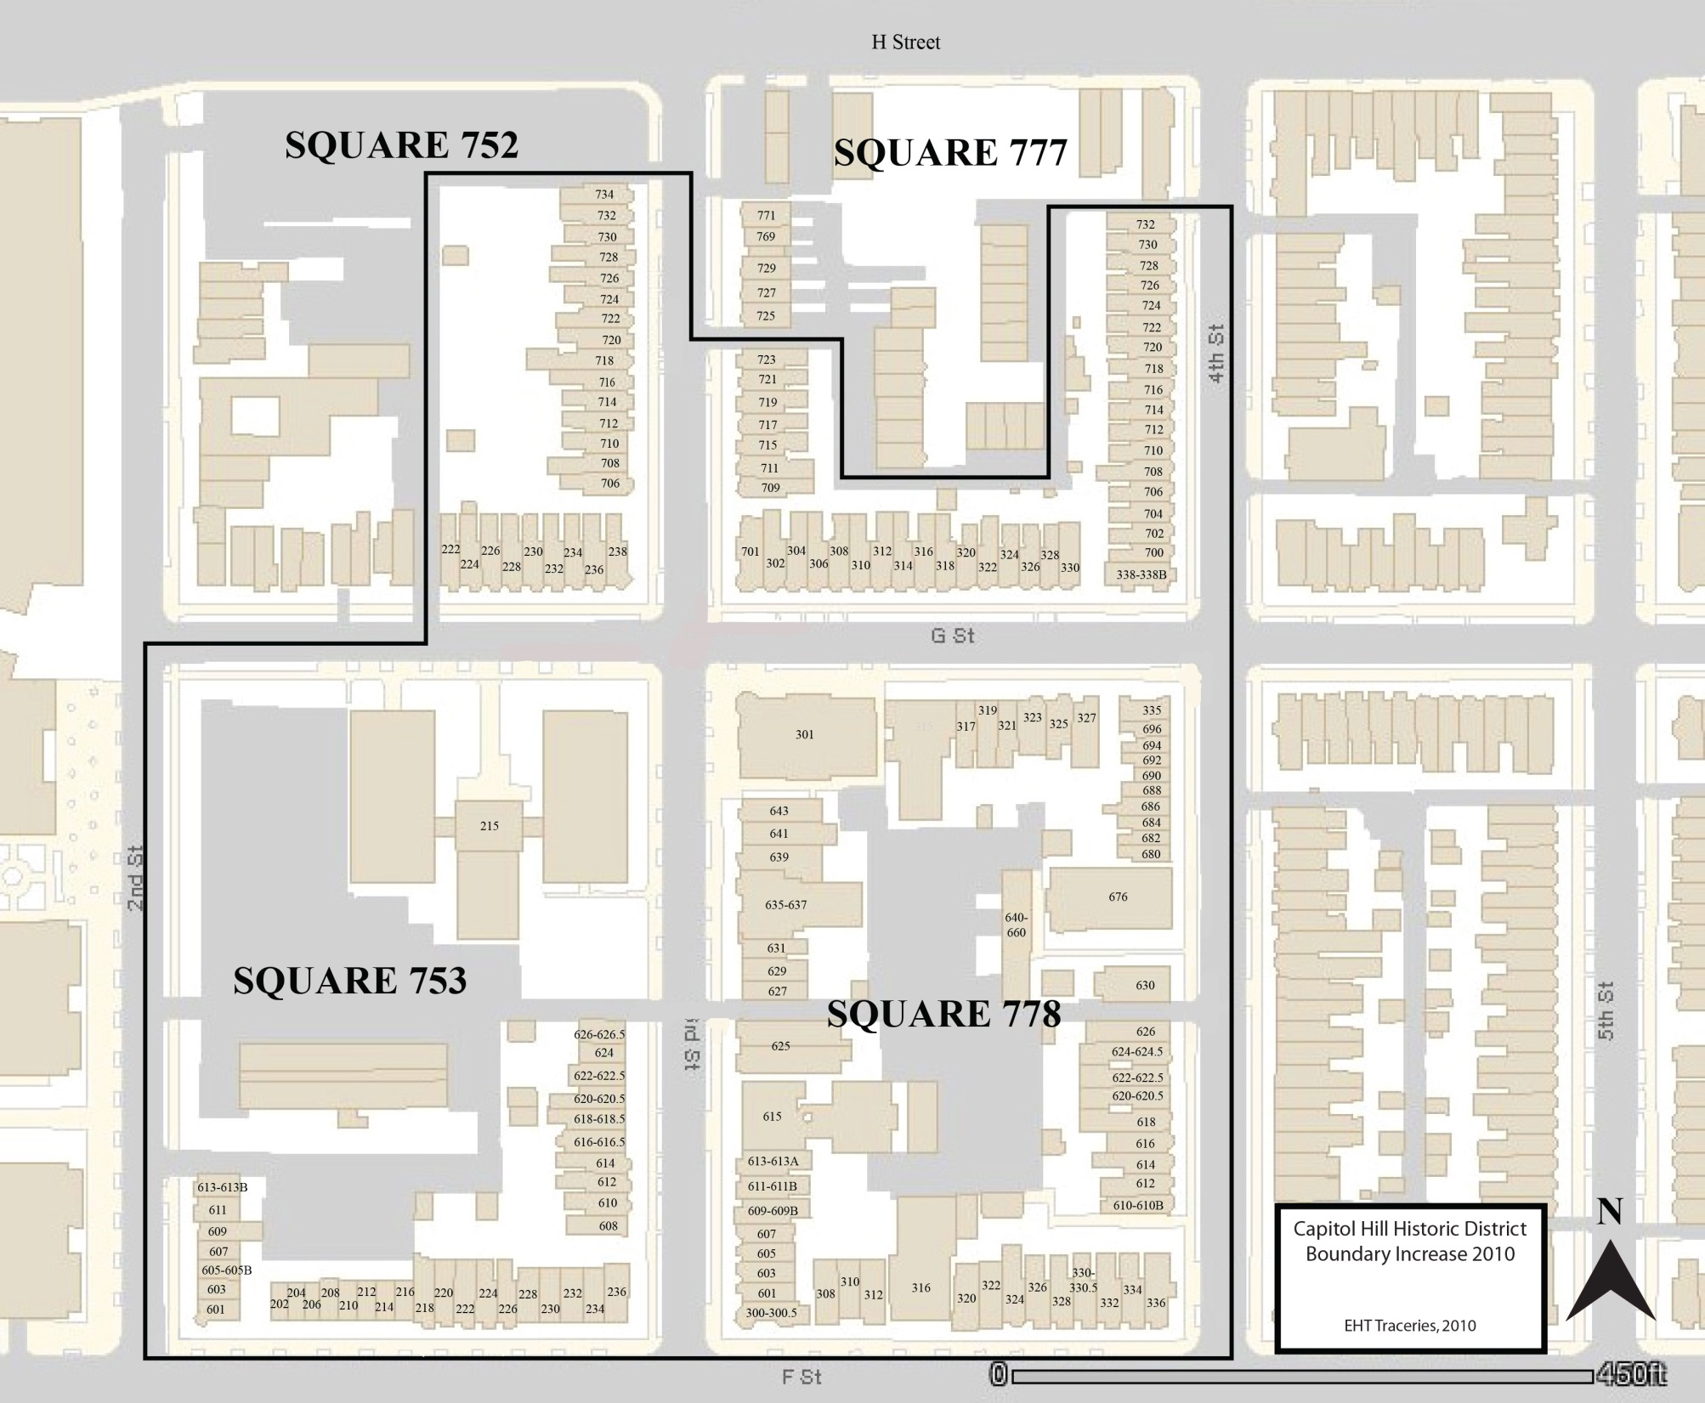

Slide 5
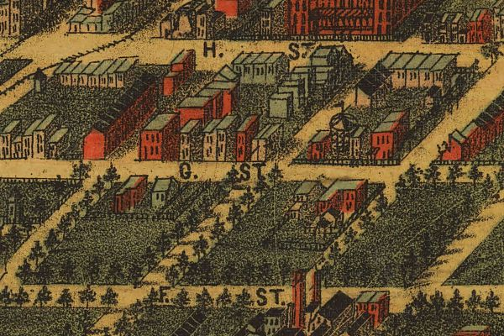
Sachse Map, 1883-1884

Slide 6
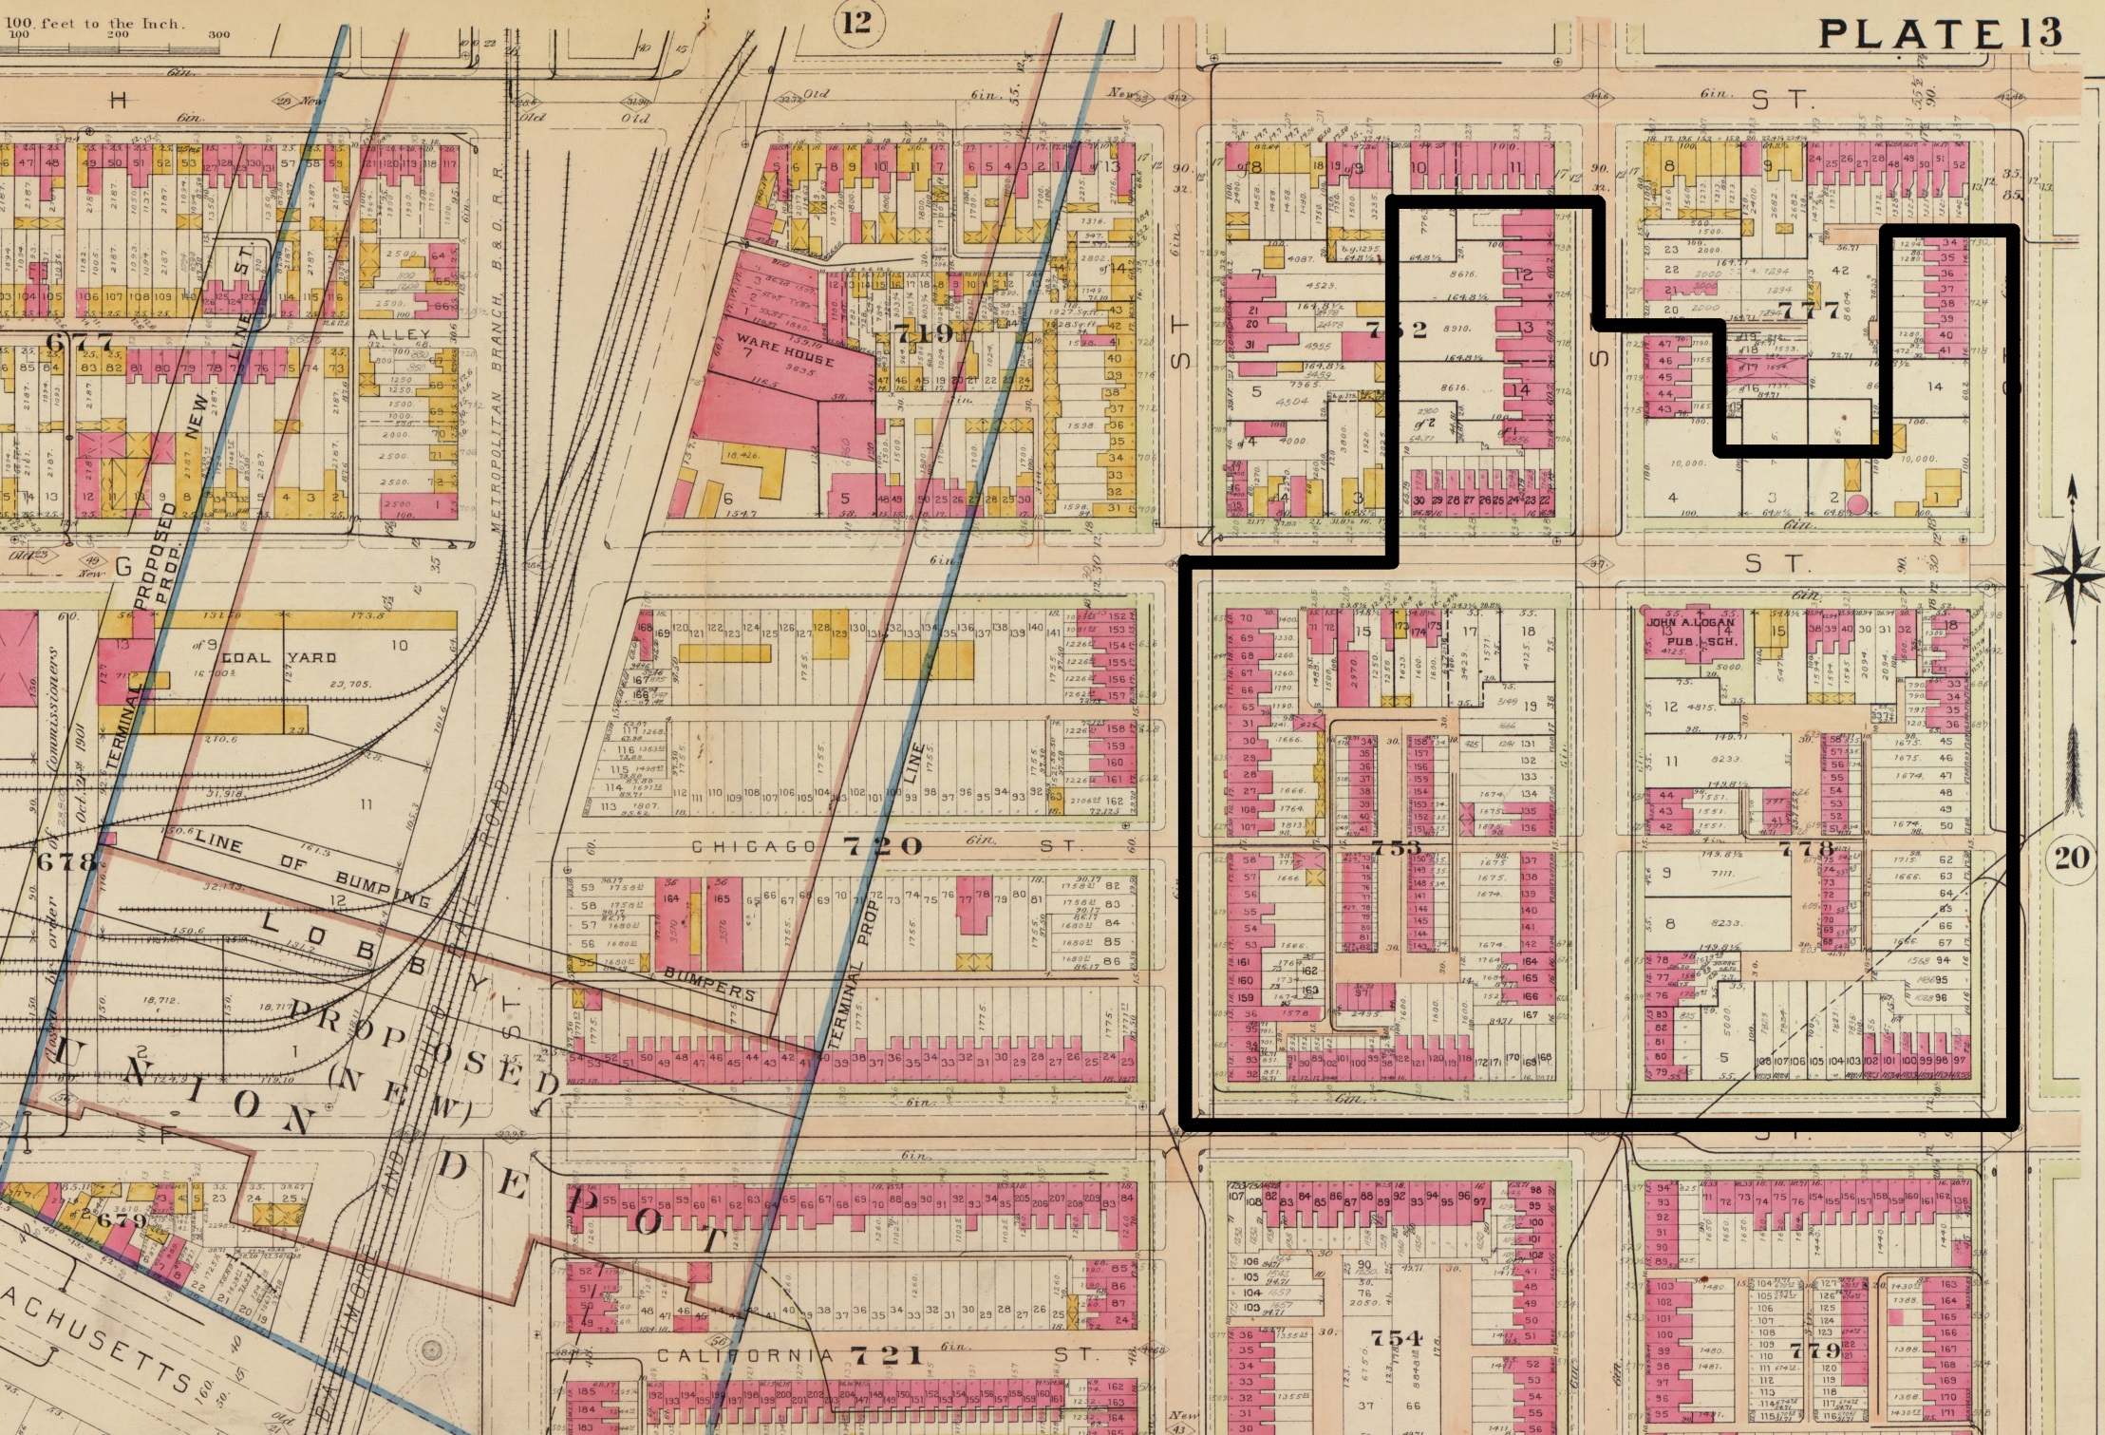
G.M. Baist Map, 1903, Vol. 2 Plate 13

Slide 7
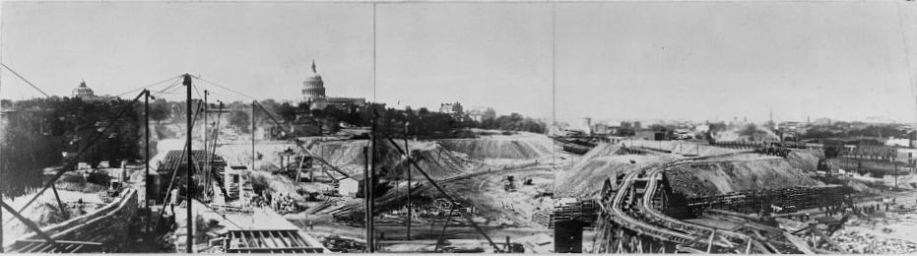
Construction of Union Station, 1908
Library of Congress

Slide 8
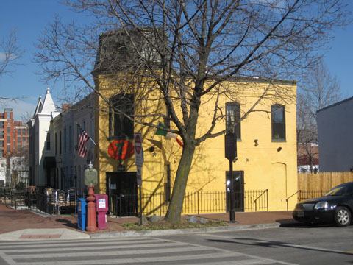
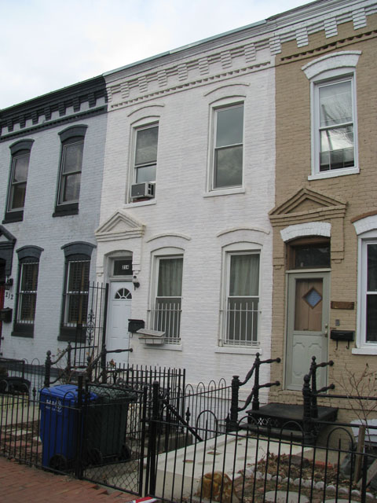
NE corner of 2nd and F Streets, N.E., looking NE
1887
216-208 F Street, N.E., looking NW
1887

Slide 9
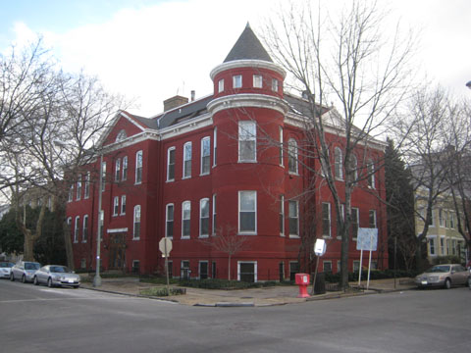
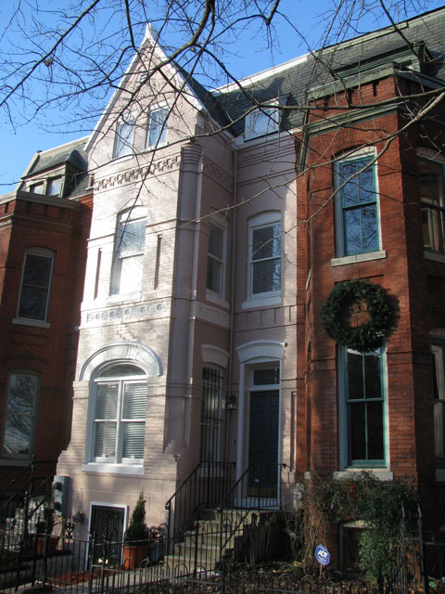
(left) 301 G Street, N.E., looking SE
1891
302-330 G Street, N.E., looking SE
1907
(left) 706-716 3rd Street, N.E., looking NE
1890

Slide 10
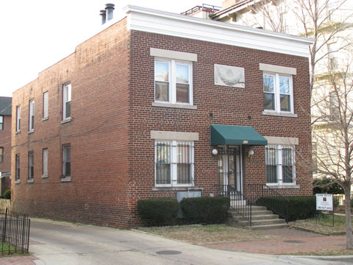
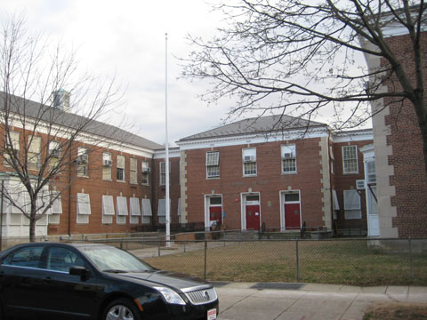
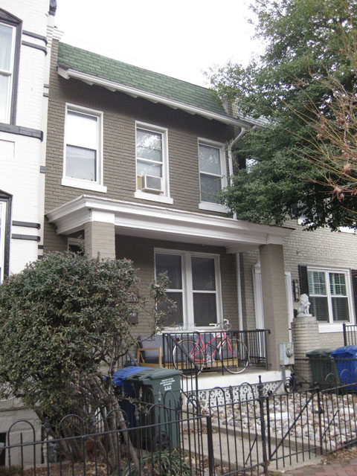
(left) 630 4th Street, N.E.
1925
215 G Street, N.E., looking SE
Logan School, 1934-5
(left) 228-236 F Street, N.E.
1922

Slide 11
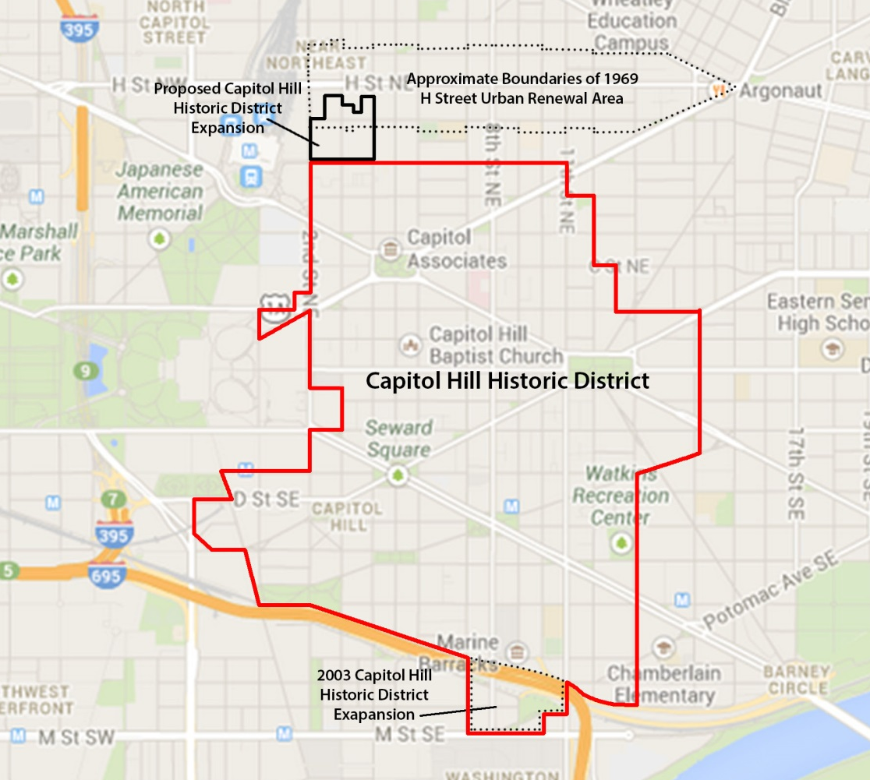

Slide 12
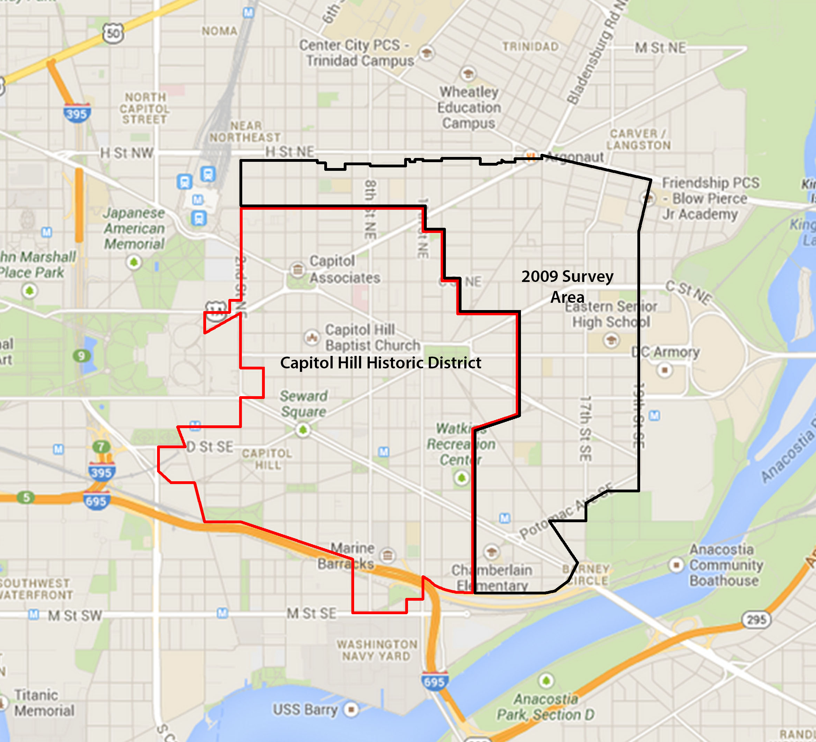

Slide 13
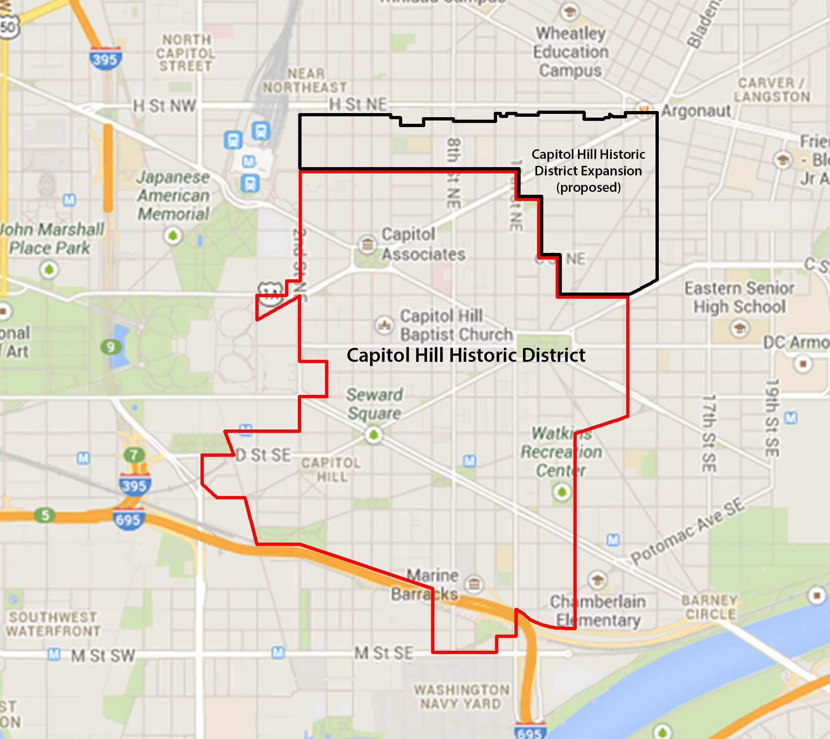

Slide 15
